Slide 1
Threat Analysis
&
Risk Assessment
As per ISO 21434
General Notes - Vatsal Patel

Slide 2
TARA Objective
Threat Analysis
&
Risk Assessment
Input Output
Item Definition
Cybersecurity Goal (Requirements)

Slide 3
Methodology
Item Definition
Function
Asset
Damage Scenario
Impact
Risk Level
Threat
Threat Scenario
Risk Value Determination
Cybersecurity Goal
Cybersecurity Properties
Attack Path
Attack Feasibility
Risk Treatment

Slide 4
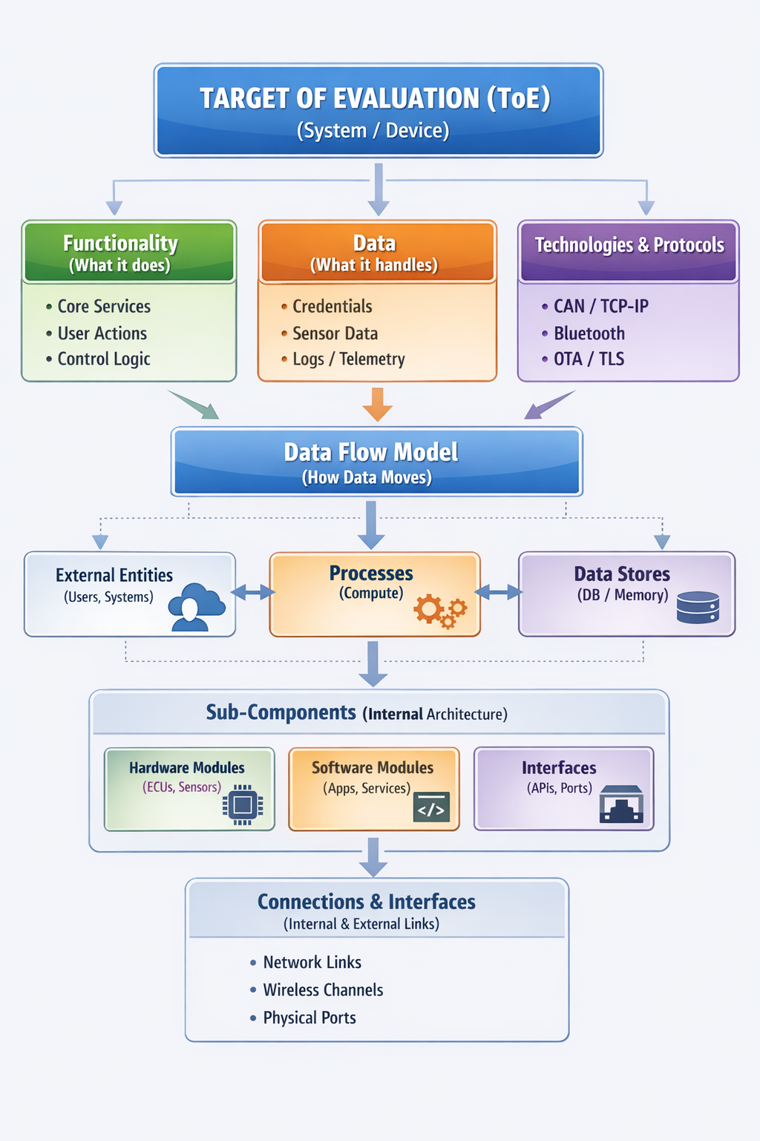
Modeling Item / Target of Evaluation (ToE)
Functions
Data
Technologies
Components and Connections
Data Flow
Diagram
Mapping
  Component - Function
  Function - Data Flow
*Image generated by providing written description to ChatGPT

Slide 5
Cybersecurity Relevance
E/E?
ASIL?
E/E component?
Safety Relevant?
Stores or processes Personally Identifiable Information?
Interconnected?
PII?
Networked?
Not Cybersecurity Relevant
Cybersecurity Relevant

Slide 6
Item / Target of Evaluation (ToE) Definition [WP-09-01]
All Product Information
Main Function
Architecture
Operational Environment
Scope

Slide 7
Asset Identification
Damage Scenario [WP-15-01]
Relationship between functionality and adverse consequences.
Description of damage/harm to the road user
Assets with Cybersecurity properties, [WP-15-02]
whose compromise leads to harm situation.

Slide 8
Threat Scenario Identification [WP-15-03]
Specific Asset
Compromises cybersecurity property
Cause of compromise
Method, tools, attacker, attack surface
Methods
Identification of abuse and misuse cases
Framework - STRIDE

Slide 9
Potential Threat
Data Element | S | T | R | I | D | E
External Entity | X |  | X
Data Flow |  | X |  | X | X
Stored Data |  | X | X | X | X
Data Process | X | X | X | X | X | X

Slide 10
Impact Rating [WP-15-04]
Impact Categories:
Safety Annex F.2 (derived/reused from ISO 26262-3:2018, 6.4.3)
Financial Annex F.3
Operational Annex F.4
Privacy Annex F.5
Degree of Impact:
Severe, Major, Moderate, Negligible.
Note:
Impact with the highest criticality from any of these four category shall be analyzed, rest can be omitted.

Slide 11
Attack Paths [WP-15-05]
Attack Surface & Proximity
Physical (e.g. Pins, Connectors…)
Local (e.g. LIN, CAN, USB…)
Adjacent (e.g. BT, WI-FI, Sensor…)
Remote (e.g. Internet, Backed…)

Slide 12
Attack Feasibility Rating [WP-15-06]
Attack Vector:
Physical, Local, Adjacent, Network
Attack Potential:
Elapsed time, expertise, system knowledge, window of opportunity, Equipment.
CVSS 3.1 (or 4.0): Exploitability Metrics:
Attack Vector, Attack Complexity, (Attack Requirement,) Privileges required, User Interaction

Slide 13
Risk -Value Determination [WP-15-07] & -Treatment [WP-15-08]
Impact Rating | Attack Feasibility Rating
 | Very low | Low | Medium | High
Severe | 2 | 3 | 4 | 5
Major | 1 | 2 | 3 | 4
Moderate | 1 | 2 | 2 | 3
Negligible | 1 | 1 | 1 | 1
Treatment
Accept (Reatin)
Transfer / Share
Avoid
Reduce / Mitigate

Slide 14
Cybersecurity Activity & Work products (as per ISO 21434)
Sub-claauses | Work Products (WP)
Concept Phase
9.3 Item Definition | [WP-09-01] Item Definition
9.4 Cybersecurity Goals | [WP-09-02] TARA [WP-09-03] Cybersecurity Goal …
Threat Analysis and Risk Assessment Methods
15.3 Asset Identification | [WP-15-01] Damage Scenarios [WP-15-02] Assets with Cybersecurity Properties
15.4 Threat Scenario Identification | [WP-15-03] Threat Scenarios
15.5 Impact Rating | [WP-15-04] Impact ratings with associated Impact Categories
15.6 Attack Path Analysis | [WP-15-05] Attack Paths
15.7 Attack Feasibility Rating | [WP-15-06] Attack Feasibility Ratings
15.8 Risk Value Determination | [WP-15-07] Risk Values
15.9 Risk Treatment Decision | [WP-15-08] Risk Treatment Decisions

